Slide 1
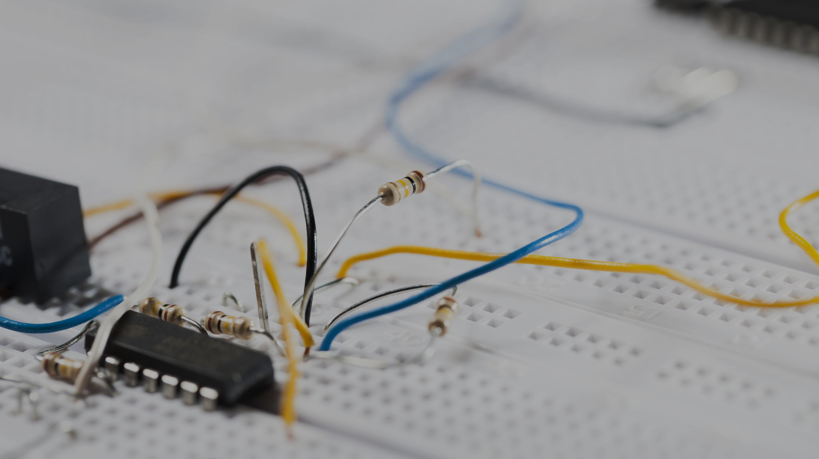
Arduino Uno
Computer Science Summer Camp 2025

Slide 2
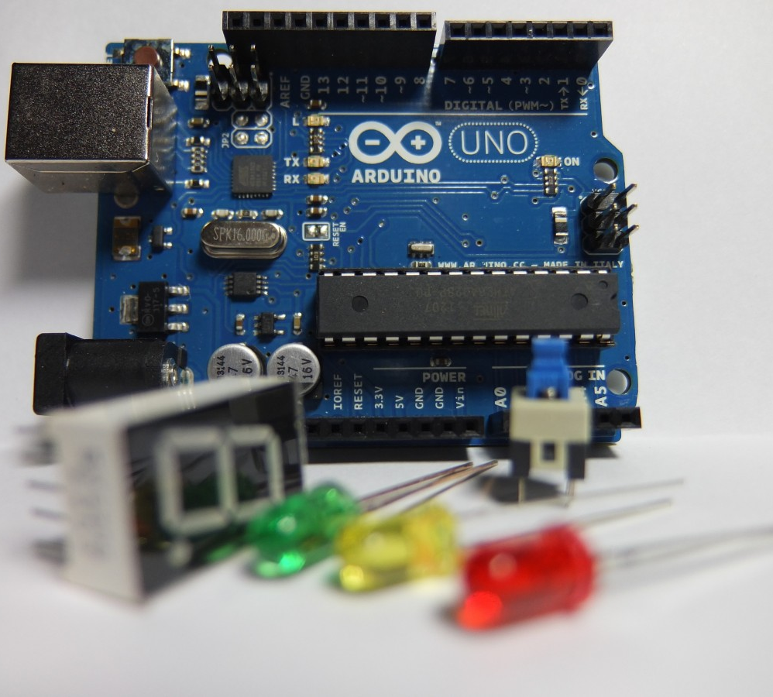
What we will cover
What Arduinos actually are.
What you can make with them.
How to program with them.
Doing even cooler stuff with them.

Slide 3
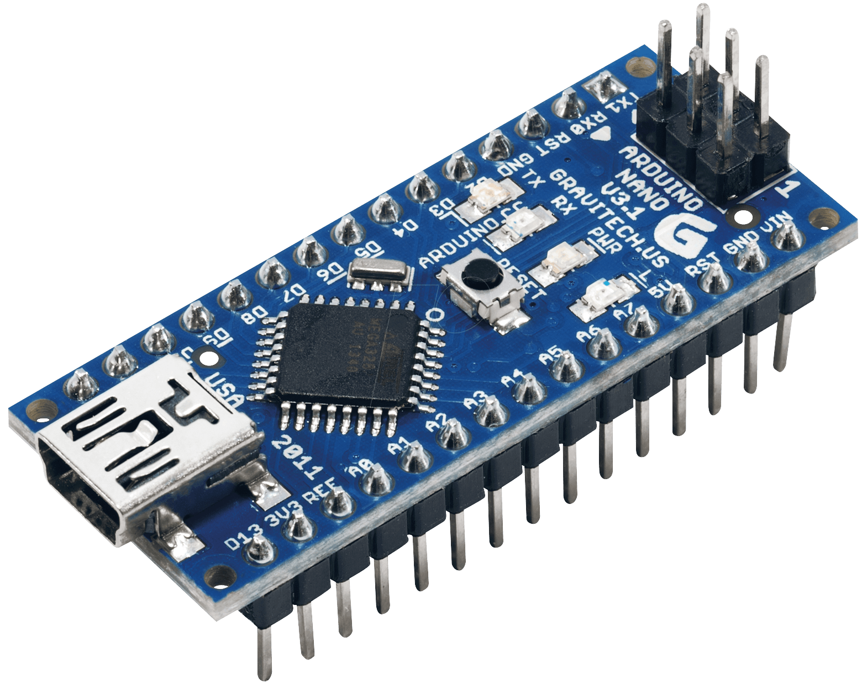
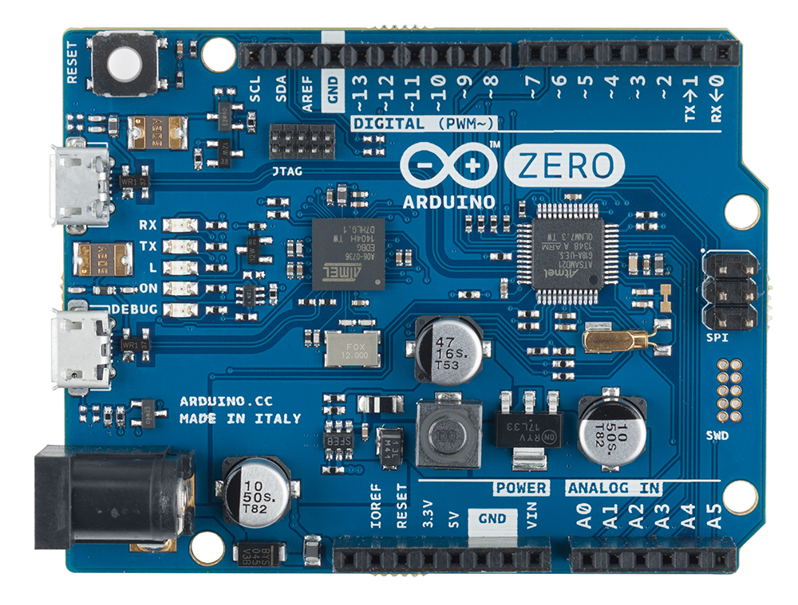
Introduction
Arduino (the company) make special kinds of computers called Microcontrollers.
They are small, modular computers that can be programmed to do basically anything.
Arduino make many kinds of microcontrollers, some even have WiFi, Bluetooth and Screens!
We are using the Arduino Uno today.

Slide 4
Uses for Arduino
Arduinos are used in thousands of projects all the time. They are pretty cheap compared to other options like Raspberry Pi’s and you can get so many different versions of them for different things.
Some come with WiFi and can connect and communicate over your networks. This works great for some projects that need to be wireless.
Arduinos
Home automation devices
IoT devices
Control boards for robots

Slide 5
Programming
What we use
How it works
If you need help
Arduinos are programmed in sketch
The language is pretty similar to C / C++
Sketch is a lot easier to use for projects and has libraries to help you do things.
First you write your code in the Arduino IDE
Then you verify your code to make sure you dont have any errors
Finally, you upload your code to the arduino over a USB cable
Don’t be afraid to Google things.
If you need some examples, have a look on the computers.
If you still need help, call over a demonstrator

Slide 6
Safety - General
Electricity can be dangerous
How to be safe
Things can heat up if you short them. Be careful when connecting wires.
Microcontrollers do not like water. Do not get them wet.
Digital electronics care about polarity. Don’t plug things in backwards.
Connect your battery after connecting things to your circuits
Move all drinks away from any electronics.
Make sure to plug batteries in the correct way.

Slide 7
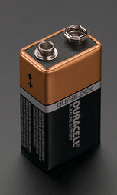
Safety – Batteries and Polarity
Why Polarity Matters
Negative Terminal
Polarity is really important when working with digital electronics like Arduinos. If we connect things backwards we can break parts of our circuits.
LEDs, Diodes and batteries have a polarity. They need to be plugged in the right way to work. Sensors and resistors usually don’t care.
5V / VCC / + are different ways of saying the positive side of a circuit. These wires are usually red
0V / GND / - are different ways of saying the negative side of a circuit. These wires are usually black
Positive Terminal

Slide 8
Projects we will cover
Blinking Light
Let’s make the light on our Arduino blink!
Use a temperature sensor to see how warm it is in the lab.
Automatic Light
Make a light turn on when it gets dark (or you put your hand over it).
Displays
Show some text on an external screen.
Displays (extra)
Show some more text and make it scroll like on a bus or train.
Temperature Logger

Slide 9
What you will need
✅: Needed
❌: Not Needed
➖: Optional
 | Blinking Light | Temperature Logger | Automatic Light | Displays
Arduino Uno | ✅ | ✅ | ✅ | ✅
Resistors | ❌ | ❌ | ✅ | ❌
Appropriate Sensor | ❌ | ✅ | ✅ | ❌
LCD Display | ❌ | ➖ | ➖ | ✅

Slide 10
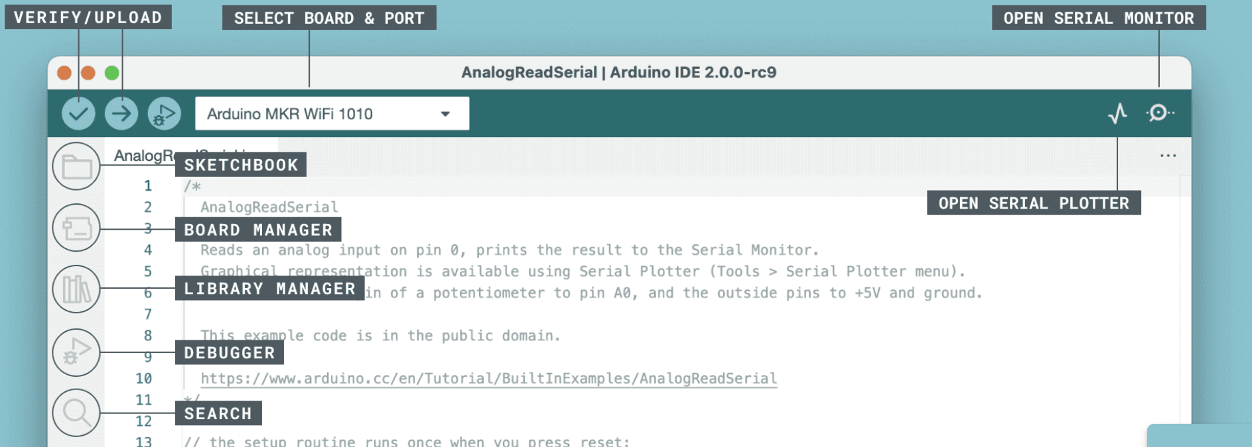
Arduino IDE
This is where you write all your code for the Arduino. Here’s a picture with all the buttons you might need to use today.

Slide 11
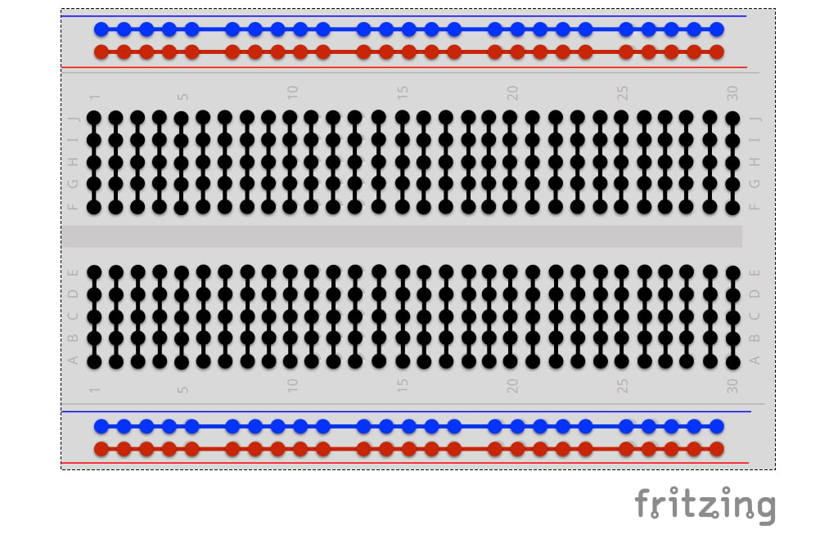
Breadboards
Breadboards are used for prototyping projects. It makes it easier to make changes to our work.
They are connected like this internally:
The edges have Power rails to supply power to all the components
These need to be connected to your Arduino.
The middle has 2 separate circuit sections.
Note: Look at the direction they connect!

Slide 12
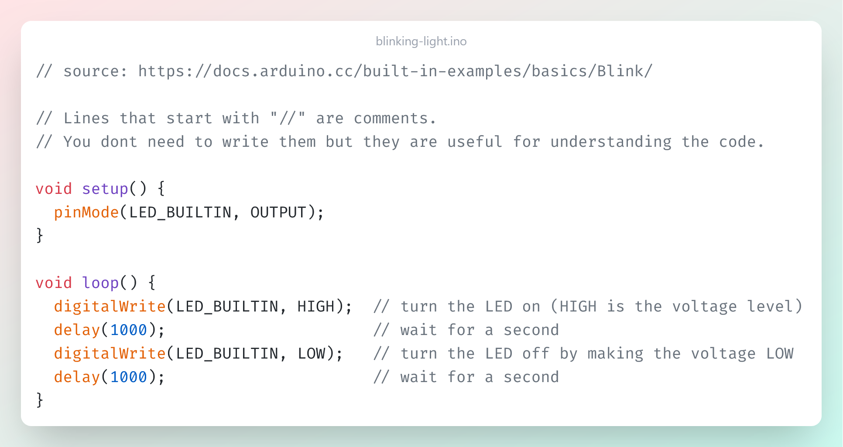
Blinking Light
Let’s Make the light on our Arduino blink!
Plug your Arduino into your pc
Open the Arduino IDE
Type the code
Click the Verify button
Click the Upload button
The light should blink!
This code is on the J drive!

Slide 13
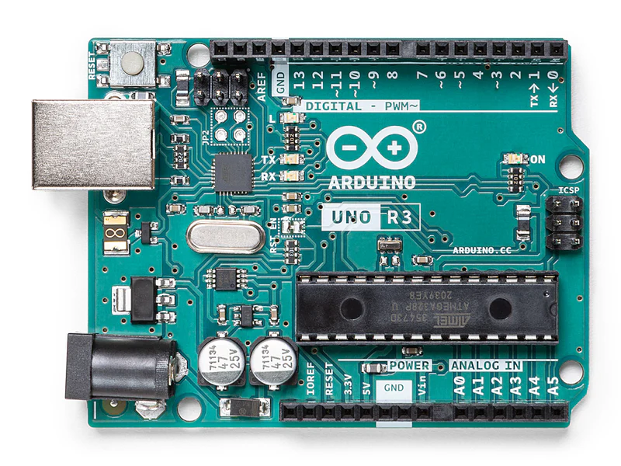
Temperature Logger
Reset Button
Copy the code from the J drive into your IDE and upload it to the Arduino.
Set up your circuit like the one on the next slide.
Click the reset button on your Arduino to restart it and open the Serial Monitor.
You should see the temperature change if you put your hands on the sensor!

Slide 14
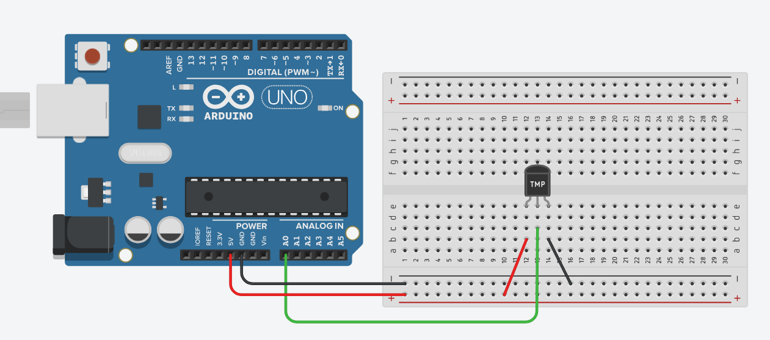
Temperature Logger Circuit Diagram
Legend
Red: 5V
Black: GND
Green: Sensor

Slide 15
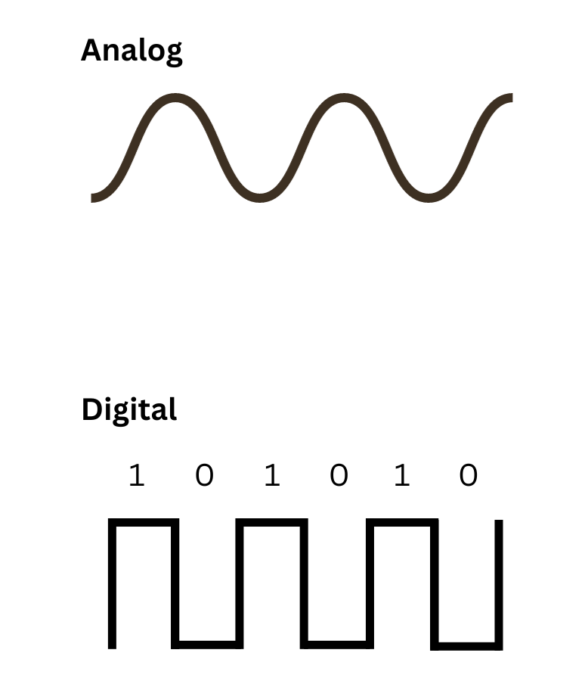
How does it work?
Most sensors are Analog components. This means they make signals that look like this.
We use the analog pins (A0 – A5) on our Arduino to read this and use it in our code. In this case we use it for temperature
Other components like Displays and USB ports carry digital signals
We can use the digital pins on our Arduino to read this.
Temperature or Humidity
Images
or Data

Slide 16
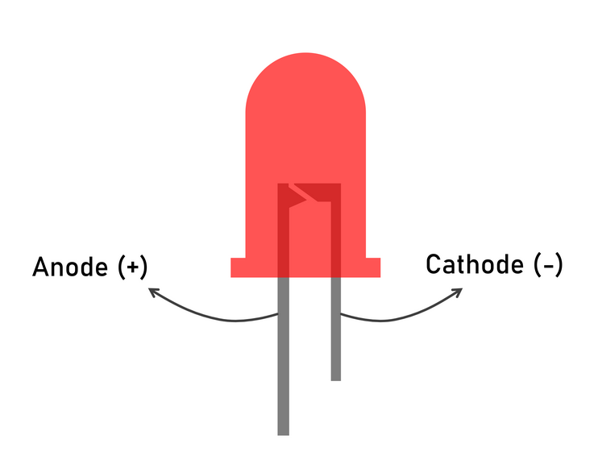
Automatic Light
LED Polarity
Copy the code from the J drive into your IDE and upload it to the Arduino.
Set up your circuit like the one on the next slide.
Click the reset button on your Arduino to restart it and open the Serial Monitor.
You should see the light turn on if you cover the light sensor!
This is for the GND cable
This is for the 5V cable

Slide 17
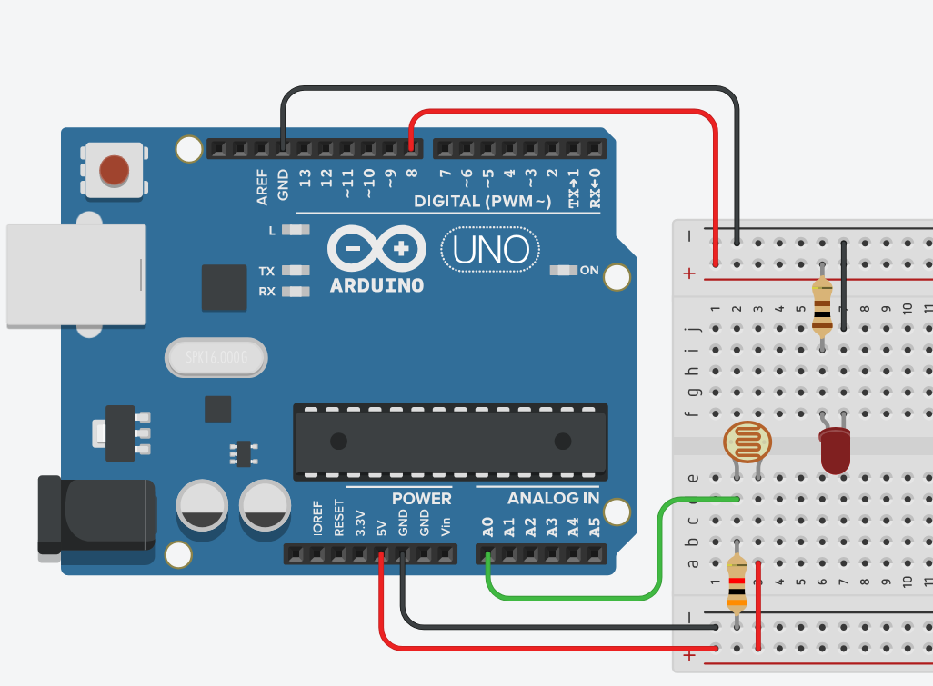
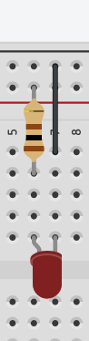
Automatic Light Circuit Diagram
Legend
Red: 5V
Black: GND
Green: Sensor
This is a 10K Ohm resistor
This is the Longer side
This is the Shorter side
This is for the GND cable
This is for the cable connected to Pin 8

Slide 18
Displays
Next, we are going to make our LCD display show some text.
This is a little more difficult but follow the diagrams and it should work.
If you want to explore the other examples instead, the code is on the J drive, but you will have to figure out the circuits yourself!
Follow a more detailed tutorials at the Arduino project book here:

Slide 19
Display Hello World!
Copy the code from the J drive into your IDE and upload it to the Arduino.
Set up your circuit like the one on the next slide.
Click the reset button on your Arduino to restart it.
You should see the LCD Display says Hello World!

Slide 20
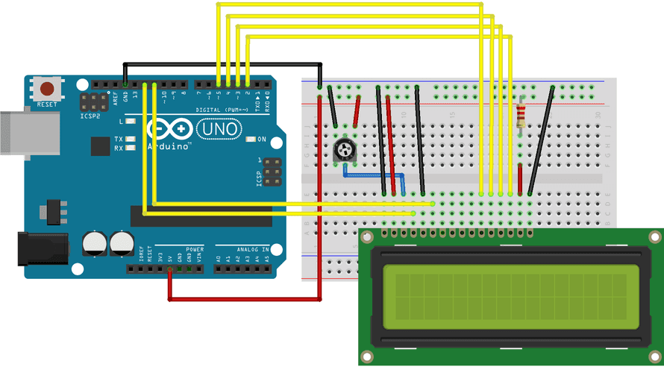
LCD Display Circuit Diagram
Legend
Red: 5V
Black: GND
Yellow: Data
(see the website below for more info)
https://docs.arduino.cc/learn/electronics/lcd-displays/

